Slide 1
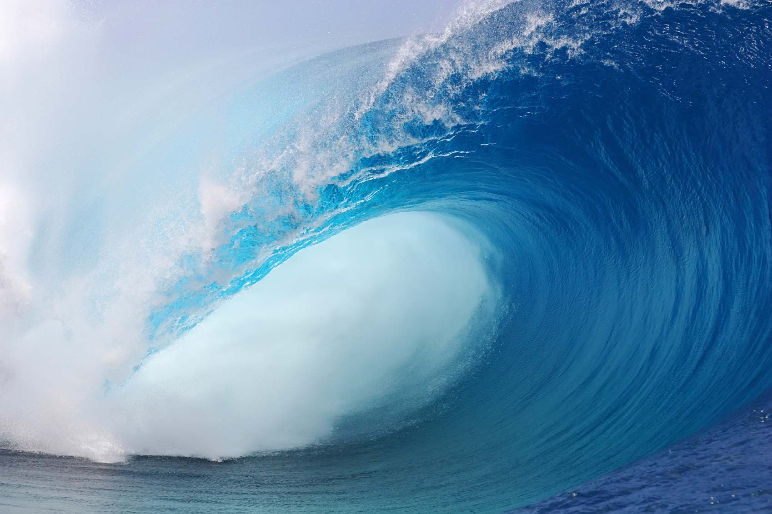
Waves
Copy
Waves – a disturbance that transfers energy from one place to another without transferring matter.

Slide 2
1. Transverse Waves – waves that move up and down
Copy
-Electromagnetic waves (including light waves) are transverse waves.

Slide 3
Crest
Copy
Wavelength
Trough
Wavelength – the distance from one point on a wave to the same point on the next wave
Crest – the highest point on a transverse wave
Trough – the lowest point on a transverse wave

Slide 4
2. Longitudinal Waves – the particles move straight out from the source, bumping each other.
Copy
Sound waves are longitudinal waves.

Slide 5
Copy
Wavelength
Rarefactions
Compressions
Compressions – the region of a sound wave where the particles are closest together
Rarefactions – the region of a sound wave where the particles are farthest apart

Slide 6
Do Not Copy

Slide 7
Do Not Copy

Slide 8
Do Not Copy
Sound/
Longitudinal
Electro-
Magnetic/
Transverse

Slide 9
How do we measure frequency?
Copy

Slide 10
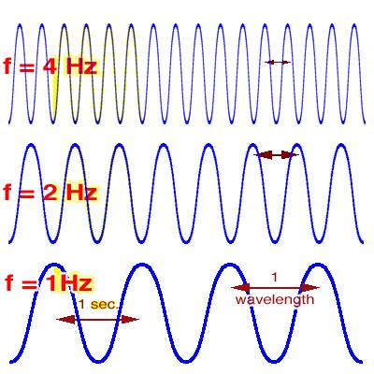
Copy
Frequency – the number of wavelengths that pass by a point each second
Unit for Frequency = Hertz (Hz)

Slide 11
Yarn & Slinky Activity - Challenge
Cut out the labels you were given.
Take the yarn and stretch it across the table between you and a partner. Move the yarn side to side on the table and observe how it moves. LABEL – wavelength, crest, and trough.
Take the slinky between two people and one person sharply push one end of the slinky forward. Observe how the slinky moves. LABEL – wavelength, compression, and rarefaction.
Take a picture and email it to Ms. Rathjen.

Slide 12
Yarn & Slinky - Challenge (Con.)
Use the yarn and see if you can make a wave that shows a high frequency.
Make part of your wave have a high frequency and the other part have a low frequency.

Slide 13
Sound Energy
Copy

Slide 14
In what type of medium does sound travel the fastest?
Copy
Gas
Liquid
Solid

Slide 15
Copy
Pitch – the perception of how high or low a sound seems
Higher frequency = higher pitch
Lower frequency = lower pitch

Slide 16
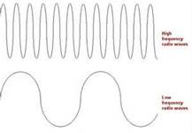
High and Low Pitched
Copy
High Frequency
Low Frequency

Slide 18
Pitch vs. Loudness
Copy

Slide 19
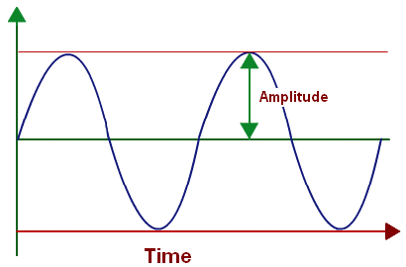
Loudness depends on the amplitude of a wave
Amplitude – the height of the wave
Copy

Slide 20
Decibels/Loudness

Slide 21
Damage of Decibels

Slide 22
How sound travels
Copy
Sound travels through longitudinal waves, also known as compression waves. They travel directly outward from the source of the vibration through particle to particle interaction.

Slide 23
Copy
Mediums – substances that sound waves travel through.
Solids
Liquids
Gases
Sound travels the fastest through solids because they are more tightly packed.

Slide 24
Does the Medium make a difference?

Slide 25
Think about a fire truck
What happens as it passes by?
http://www.animations.physics.unsw.edu.au/jw/doppler.htm

Slide 26
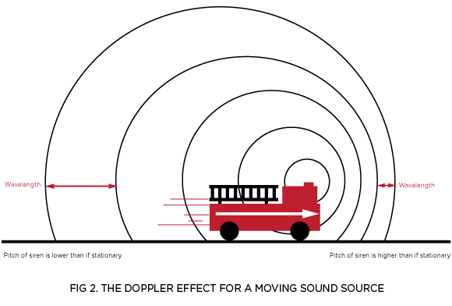
Copy
Doppler effect- change in pitch when a sound source is moving in relation to an observer

Slide 27
How old are your ears?
http://www.youtube.com/watch?v=VxcbppCX6Rk

Slide 28
How the ear hears
Copy
http://www.youtube.com/watch?v=ahCbGjasm_E
Decibels- the pressure that sound waves exert

Slide 29
Speed of Sound
Copy
Speed of sound (in air): 768 mph (343 m/s)
Watch videos http://www.youtube.com/watch?v=6o0zmafxTmE&list=PLbjgX3AqxjQVQHo3VIC7JpYnTELDWxXe3&index=5
http://www.today.com/video/today/49414119#49414119

Slide 30
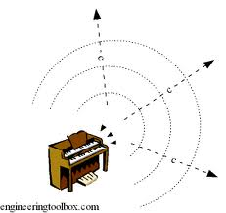
Sound Energy Recap
Copy
Sound is the result of vibrations in matter.
Sound energy is transferred by
waves
(2) spreading away from the source
(3) through particle-to-particle interaction.
Show Video

Slide 31
Recap…
Copy
Sound is the result of _____.
Vibrations in matter
How is sound energy transferred? (3 parts)
By waves
They spread away from the source
Through particle to particle interaction
The matter or material that sound waves travel through is called?
A medium
What are some examples of a medium for sound?
air, water, metal
Why can you not hear sound in space?
Because there is no medium, or particles, for sound waves to travel through.

Slide 32
Review…
What is the distance from one point on a wave to the same point on the next wave?
A wavelength
What is measured by the number of wavelengths that pass by a point per second?
Frequency
What is the unit for frequency?
Hertz (Hz)
What is the range of frequencies that humans can hear?
20 Hz to 20,000 Hz

Slide 33
Review…
Which has the highest frequency?
A
B
C
Fill in the blank…
The shorter the wavelength, the _______ the frequency.
The longer the wavelength, the _______ the frequency.

Slide 34
Review…
The perception of how high or low a sound seems is the _______?
Pitch
Fill in the blanks…
The higher the frequency, the ______ the pitch.
The lower the frequency, the ______ the pitch.
Longitudinal vs. transverse wave?
Draw a wave and label the crest, trough, and wavelength.

