Slide 1
Thermal Energy
Thermal Energy - energy due to the random motion (kinetic energy) of molecules or atoms in a substance.
Temperature – a measure of the average kinetic energy of the particles in an object or substance.

Slide 2
Reading a thermometer…
The mercury (or other substance) in a thermometer expands and contracts with changes in temperature.
When particles of a substance heat up, they move faster and expand.
Measured in degrees Celsius (°C), degrees Fahrenheit (°F), or Kelvin (K).
(Hold plastic part of thermometer so the temperature of your hand does not affect the reading.)

Slide 3
Converting (Challenge)
°F = °C x 9/5 + 32
°C = (°F – 32) x 5/9
Ex1: Convert 70°F to °C
= 21°C
Ex2: Convert 90°C to °F
= 194°F

Slide 4
Challenge only… (cont.)
Ex3: Convert 25°F to °C.
= - 4°C
Ex4: Convert 40°C to °F.
= 104°F

Slide 5
Sand Lab
Question: How will adding kinetic energy to sand by shaking it for 5 minutes affect its temperature?
Materials:
Container w/ lid
Sand
Thermometer
Timer

Slide 6
Procedures:
Measure the temp. of the sand in °C and record.
Put the lid of the container on tightly.
Shake rapidly for 1 minute.
Open lid and record temp.
Repeat steps 2-4 for a total of 5 minutes.
Graph data.

Slide 7
IV: Shaking the sand (adding kinetic energy)
DV: Temperature of the sand
Constants: sand, container, timer, thermometer
Hypothesis: If we add kinetic energy to sand by shaking it for 5 minutes, then _________, because __________.

Slide 8
Data Table:
Temperature of Sand over 5 Minutes
Time (minutes) | Temperature (°C)
0
1
2
3
4
5

Slide 9
Let’s Graph it!

Slide 10
Write a power conclusion!
The purpose of the investigation was to _________________________________________________________________
_________________________________________________________________________________________________.
I thought that (restate your hypothesis) _________________________________________________________________
_________________________________________________________________________________________________.
I found out that ____________________________________________________________________________________.
My hypothesis was/was not supported. My data shows ___________________________________________________
_________________________________________________________________________________________________.
Possible errors, such as _________________________, could have affected my results because ____________________
_________________________________________________________________________________________________.
We have been studying thermal energy and the data proves (say what is proves about thermal energy)
_________________________________________________________________________________________________.
In the future, I could extend my research by ______________________________________________________________.
This experiment could have been improved by ____________________________________________________________.

Slide 11
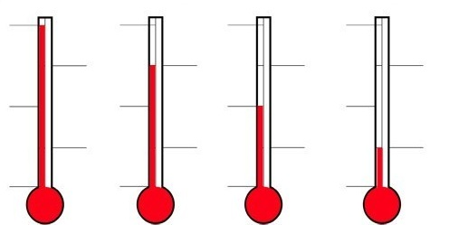
QOD#54
Which thermometer has the greatest thermal energy? Why?
100°C
100°C
100°C
100°C
0°C
0°C
0°C
0°C
A
B
C
D

Slide 12
QOD#54
Which thermometer has the greatest thermal energy? Why?
Thermometer A. As the thermometer is heated (thermal energy added) the particles in the liquid speed up (gain kinetic energy) and expand. In thermometer A the liquid has expanded the most, having the most thermal energy.
A
B
C
D

Slide 13
Conductor & Insulator Notes
Thermal Conductor – a material that allows heat to flow through it easily
ex:
Thermal Insulator – a material that does not allow heat to flow through it easily
ex:

Slide 14
Insulator Test
Purpose: The purpose of this investigation is to determine which material is a better insulator of thermal energy.
Materials: 2 plastic cups, styrofoam cup, paper cup, coffee cup, hot water, thermometer, & lids for the cups

Slide 15
Procedures
Pour hot water into five cups: 2 plastic, 1 paper, 1 styrofoam, and 1 travel coffee cup.
Find the starting temperature of the water in each cup and record it on the table.
Place the lids on the cups, the four cups (leave one plastic cup without a lid).
After 15 minutes, open the lids and find the temperature of the water in each cup and record it on the table.
Find the temperature difference for each cup.

Slide 16
IV:
DV:
Control:
Constants:
Hypothesis: If we pour hot water into 4 different kinds of cups, I believe that ______________, because ____________.

Slide 17
Temperature Change After 15 Minutes Insulator Test
Type of cup | Starting temp. | After 15 min | Temp. Change
Plastic cup w/ lid
Paper cup w/ lid
Styrofoam cup w/ lid
Travel coffee cup w/ lid
Plastic w/o lid

Slide 18
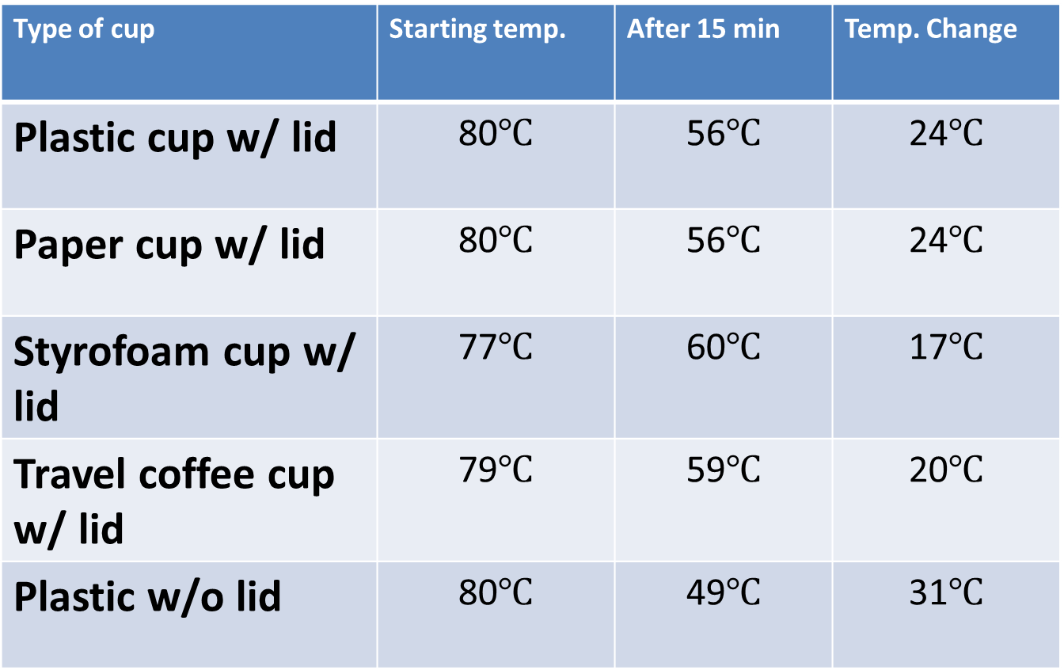
Temperature Change After 15 Minutes Insulator Test
Type of cup | Starting temp. | After 15 min | Temp. Change
Plastic cup w/ lid | 80$℃$ | 56$℃$ | 24$℃$
Paper cup w/ lid | 80$℃$ | 56$℃$ | 24$℃$
Styrofoam cup w/ lid | 77$℃$ | 60$℃$ | 17$℃$
Travel coffee cup w/ lid | 79$℃$ | 59$℃$ | 20$℃$
Plastic w/o lid | 80$℃$ | 49$℃$ | 31$℃$

Slide 19
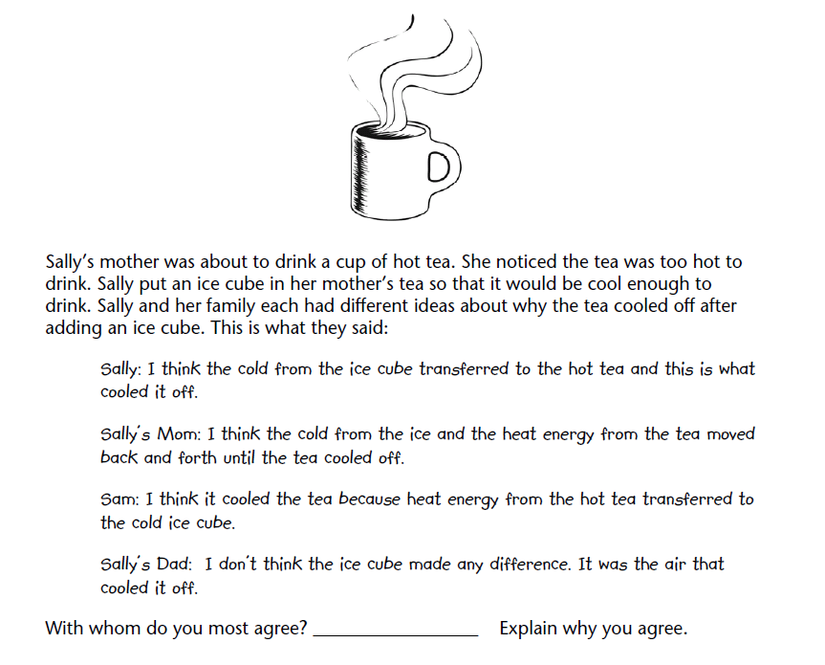
QOD 5 - Page Keeley Probe

Slide 20
Temperature change After 15 Minutes Conductor Test w/ Ice & Soda
Material | Starting Temp | Average Ending Temp
Metal Can | 21 C | ______C
Plastic Bottle Glass Bottle | 21 C 21 C | ______ C ______C

Slide 21
Movement of Heat
Thermal energy is transferred as heat from warmer objects to cooler objects until both reach the same temperature (equilibrium).
Energy is transferred from the soup to the air around it.
-Eventually the thermal energy will transfer until they reach the same temperature.
warmer
cooler

Slide 22
Hot & Cold Water Reaching Equilibrium in Room Temperature
Time (minutes) | Hot Water Temp. (°C) | Cold Water Temp. (°C)
0
5
10
15
20
What is your prediction for the temps after 30 min? After an hour?

Slide 23
Holding an Ice Cube
Why does the ice cube melt when it is held in your hand?
-The thermal energy from your hand is transferring to the ice cube.
-The thermal energy of your hand decreases, and the thermal energy of the ice cube increases.
When does the transferring of the thermal energy stop?
-When the water and your hand are the same temperature.

Slide 24
HW: Movement of Heat Questions

Slide 25
Heat Transfer Questions…
A hot cup of coffee in room temp.
Putting an ice cube in your mouth
Stepping outside in the snow barefoot
Touching a hot pan that came out of the oven
A doctor’s stethoscope on your back
Holding a cold can of soda
A popsicle dropped on concrete

Slide 26
QOD # 6
Ms. Rathjen wore her heavy winter coat when she went outside because it was freezing cold! Describe the direction of heat transfer and the purpose of the coat.

Slide 27
Heat Transfer Questions… The heat transfers from the ___________ to the ___________.
A hot cup of coffee in room temp.
Putting an ice cube in your mouth
Stepping outside in the snow barefoot
Touching a hot pan that came out of the oven
A doctor’s stethoscope on your back
Holding a cold can of soda
A popsicle dropped on concrete

Slide 28
3 Ways of Transferring Heat

Slide 29
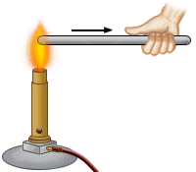
1. Conduction
The transfer of heat by direct contact (by touch).
Ex: touching snow,
Touch hot metal

Slide 30
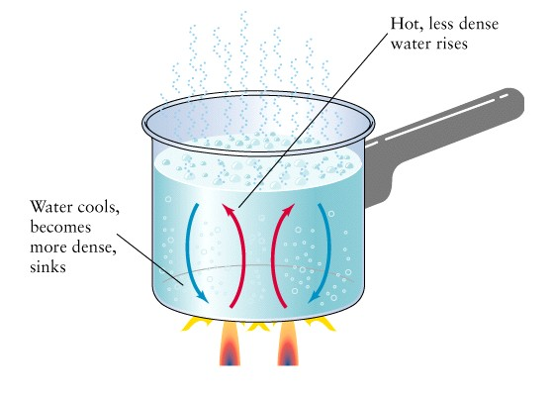
2. Convection
The transfer of heat in a fluid (gas or liquid) as a result of the movement of the fluid.
Ex: living room
heated up,
heating up a
pot of water

Slide 31
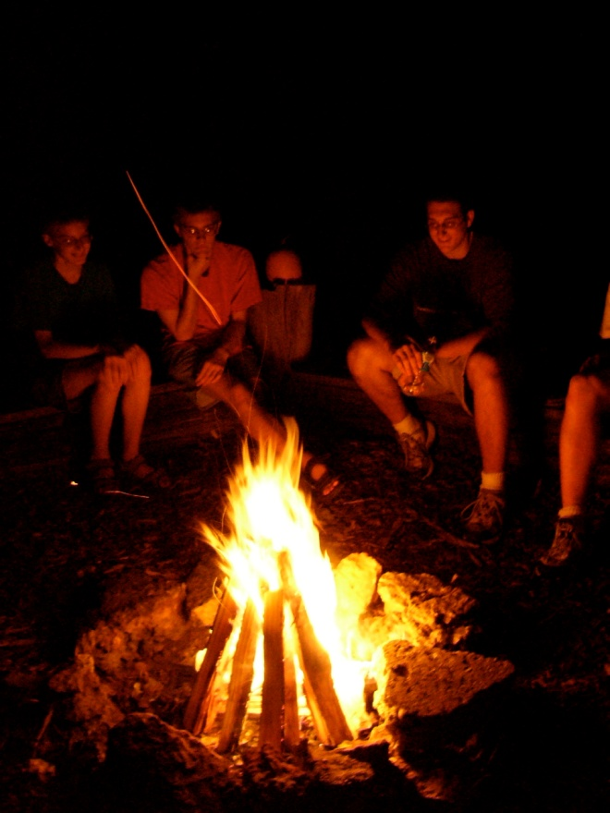
3. Radiation
The transfer of heat through electromagnetic waves. (heating without direct contact)
Ex: microwave, the sun,
fire heating you up,
a light bulb

Slide 33
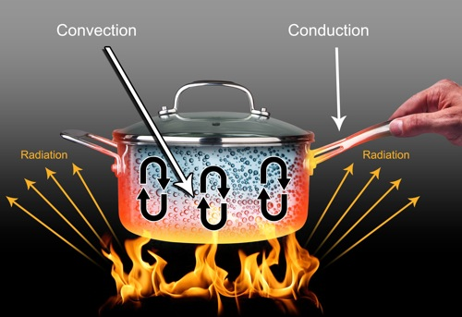

Slide 34
Convection
Diagram:
(leave yourself a half of page for your diagram)
(include labels)
Explain what happens to the water as convection is occurring.

Slide 35
Convection of Boiling Water – Density Explanation
As the water molecules heat up in the bottom of the pan, they move faster and spread out, which makes them less dense. The less dense, heated molecules rise to the top. The molecules on top that cool off sink to the bottom, where they warm up again and rise back to the top.

Slide 36
Concluding paragraph…
How is popping popcorn a good example of conduction, convection, and radiation?
A paragraph is AT LEAST 5 sentences.
Intro sentence, explain conduction example, explain convection example, explain radiation example, concluding sentence

Slide 37
Salt & Ice
Question: How does adding salt to ice affect the temperature of the soda over 30 minutes?
Time (min) | Soda from Ice Cooler | Soda from Ice and Salt Cooler
0
10
20
30

Slide 38
Create a DOUBLE LINE graph

Slide 39
QOD#59
A pot of water is boiling on the campfire. You are sitting close enough to feel the heat of the fire. (Give an example of each of the types of heat transfer.)
Conduction:
Convection:
Radiation:

Slide 40
Heat transfer (ICE CREAM!) Lab
Purpose: The purpose of this experiment is to see if adding salt to the ice will allow the transfer of thermal energy to result in the freezing of ice cream.
Materials: (see directions)
Procedures: (see directions)

Slide 41
Hypothesis: If we add salt to the ice, then ______________________________, because ________________________________.
IV:
DV:
Constants:

Slide 42
Data and observations
Qualitative: (describe what you saw, felt, heard)
Quantitative:
Beginning temp of ice only | Ending temp of ice an salt

Slide 43
Questions
Describe the direction of heat transfer in this experiment. Is it convection, conduction, or radiation?
What is the purpose of using the salt?

Slide 44
Power Conclusion

