Slide 1
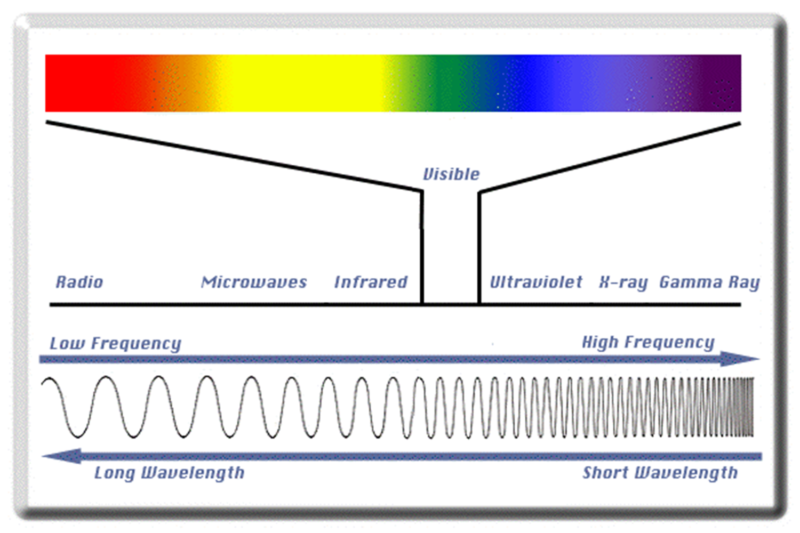
The Electromagnetic Spectrum

Slide 2
Radio Waves
Longer wavelengths that travel at the speed of light
Commonly used for radios, older television stations and some older cell phones.

Slide 3
Microwaves
Slightly higher frequency than radio waves but still travels at the speed of light
Used in modern cell phones, microwaves and satellites

Slide 4
Infrared waves
Just slightly longer wavelengths than visible light it travels at the speed of light
Used in night vision goggles, thermal imaging in satellites and remotes.

Slide 5
Visible Light
Light that you can see.
Colors
Red
Orange
Yellow
Green
Blue
Indigo
Violet

Slide 6
Ultraviolet rays
Shorter wavelengths than visible light and travels at the speed of light
Can be used to sterilize medical equipment, quickly harden special adhesives and highlighters.

Slide 7
X-rays
Even shorter wavelengths and therefore greater energy but still travels at the speed of light
Can be used in medical x-rays, security checkpoints and NDI (non-destructive inspection) devices to check welds for imperfections.

Slide 8
Gamma rays
Extremely high energy with the shortest wavelengths (still travels at the speed of light)
Can be used to attack cancerous cells in the human body, food sanitation and extremely detailed images of the cargo shipments.

