Slide 1
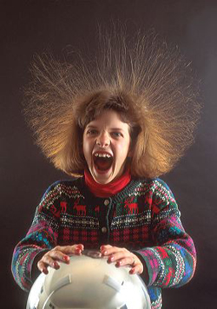
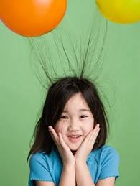
Static Electricity

Slide 2
copy
Electrical Energy – the energy of moving electrons.
Atoms are made up of protons, neutrons, & electrons.

Slide 3
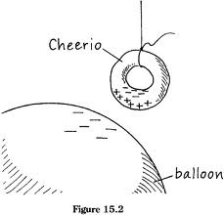
copy
Static electricity is the result of the transfer of electrons. The imbalance of positive and negative charges.

Slide 4
copy
Same/like charges move apart, or repel each other.
Opposite charges move together, or attract each other.

Slide 5
Static Electricity
copy
Most objects have no overall charge and are neutral.
Uncharged objects become charged by gaining or losing electrons.
If it LOSES electrons it will have a POSITIVE charge.
If it GAINS electrons it will have a NEGATIVE charge.

Slide 6
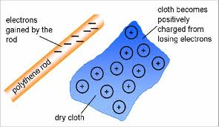
copy

Slide 7
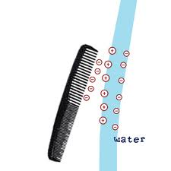
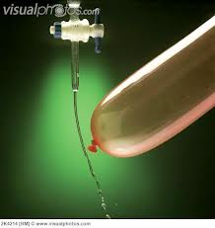
Balloon and water

Slide 8
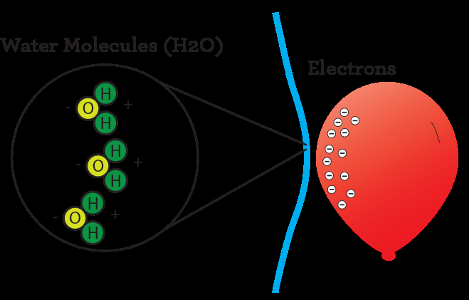
copy

Slide 9
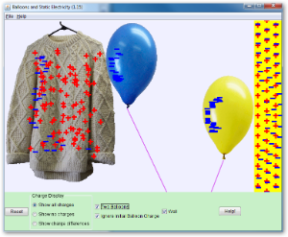

Slide 10
copy
Static discharge – the release of static electricity when two objects are left neutral after the discharge.
Can occur slowly – when your hair loses its static charge over a couple of minutes.
Can occur quickly – when you get shocked when you touch something; another example is lightning.

Slide 11
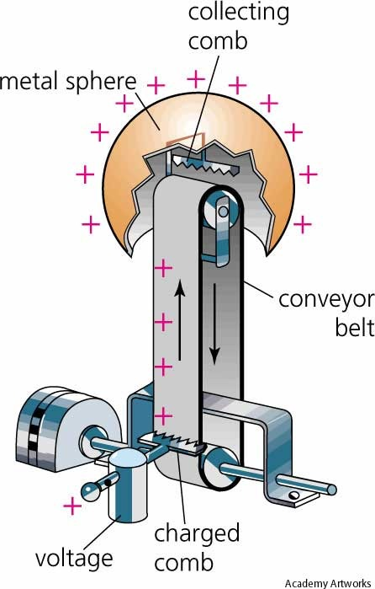
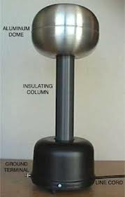
Van de Graaf generator

Slide 12
World’s Largest Van de Graaf Generator
http://www.youtube.com/watch?v=sy05B32XTYY

