Slide 1
Monday, September 23
Have Study Guide on desk
QOD #17
What are you going to do to study for the test tomorrow?

Slide 2
Go over study guide!

Slide 3
Measuring Matter Baseball

Slide 4
Rules of the Game – Review Baseball
2 teams
4 bases – 1st, 2nd, & 3rd around the room
1 team bats at a time
1 person will answer question w/o help from team
Right – go to 1st base
Wrong – question goes to other team (they can get ½ pt for correct answer, if they miss it the question dies), team gets an out.
3 outs and runners sit, other team bats.
If a batter gets home, team scores a run.
If a team scores 2 runs in an inning, teams switch.
Each batter has about 10-20 seconds to answer – depending on question.
Participation Points – Everyone write answers on piece of paper for pts.
Teams talking/sharing answers lose points.
Winning team earns bragging rights!!

Slide 5
1. _________ is anything that takes up space and has mass.
Matter

Slide 6
2. Give a non-example of matter.
Light, sound, electricity, thoughts, emotions, etc.

Slide 7
3. Make a qualitative observation of your table.
It is tan colored
It is smooth

Slide 8
4. Make a quantitative observation of your table.
The table has four legs

Slide 9
5. Which metric unit would you use to measure the length of your pencil or pen?
cm

Slide 10
6. Share the metric units in order from smallest to largest: km, mm, cm, m.
mm, cm, m, km

Slide 11
7. Which metric unit should you use when you measure the volume of a text book?
cm³

Slide 12
8. Which metric unit would you use to measure the distance from the back wall to the front wall of my classroom?
Meters (m)

Slide 13
9. Which metric unit would you use to measure the volume of lemonade in a graduated cylinder?
mL

Slide 14
10. Which metric unit would you use when measuring the mass of a bottle of glue?
Grams (g)

Slide 15
11. Which metric unit would you use for the density of a liquid?
g/mL

Slide 16
12. Which metric unit would you use for the density of a rock (a solid)?
g/cm³

Slide 17
13. ______ is how much matter is in an object.
Mass

Slide 18
14. _______ is how much space an object takes up.
Volume

Slide 19
15. _______ is a measure of the gravitational force exerted on an object.
Weight

Slide 20
16. What happens to your mass when you go to the moon?
It stays the same.

Slide 21
17. Calculate the volume of an object with the dimensions of 3 cm by 4 cm by 2 cm. Include units.
24 cm³

Slide 22
18. A rock is placed in a graduated cylinder with 33 mL of water. After dropped in, the water level rises to 40 mL. What is the volume of the rock? Include units.
7 cm³

Slide 23
19. What happens to your weight when you go to Jupiter. Why?
It gets heavier, b/c there is more gravity.

Slide 24
20. What is the 4th step in finding the volume of an object by water displacement? 1. Fill a gc with water and measure. 2. Carefully drop the object in the water. 3. Subtract 4. ____________
Change units to cm³

Slide 25
21. What is the mass displayed on this tbb? Include units.
488.7 g or 488.8 g

Slide 26
22. _______ is how compact the particles in an object are. How much mass an object has compared to its volume.
Density

Slide 27
23. Calculate the density of a liquid with a volume of 9 mL and a mass of 27 g. Include units.
3 g/mL

Slide 28
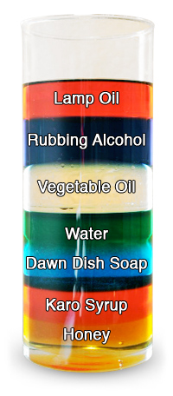
24. In the picture, which has the smallest density?
Lamp oil

Slide 29
25. A rock with a density of 1.5 g/cm³ is placed in a liquid with a density of 3.2 g/mL. Will the rock sink or float? Why?
Float, b/c the rock has a smaller density than the liquid.

Slide 30
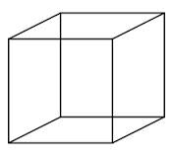
26. What is the volume of a cube with the sides measuring 2 cm?
8 cm³

Slide 31
27. Convert 89 cm to mm. Include units.
890 mm

Slide 32
28. What is the density of an object that displaces 25 mL of water and a mass of 30 g? Include units.
1.2 g/cm³

Slide 33
29. Convert 340 mL to L. Include units.
.34 L

Slide 34
30. Which metric unit would you use to measure the mass of a lion?
Kilograms (kg)

Slide 35
31. Convert 7,645 g to kg. Include units.
7.645 kg

Slide 36
32. What is one thing important to remember when you are measuring the volume of a liquid using a graduated cylinder?
Measure at eye level
Measure from the bottom of the meniscus

Slide 37
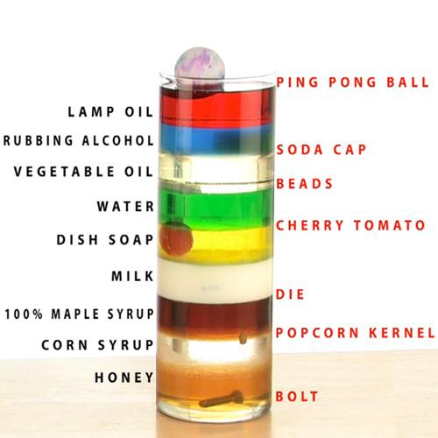
33. Which object in the density column has the smallest density?
Ping pong ball

Slide 38
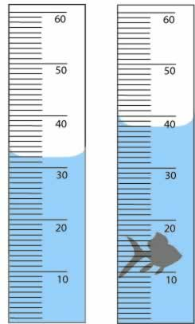
34. What is the volume of the object in the picture? Include units.
38 mL – 32 mL =
6 mL
6 cm³

Slide 39
35. What is the volume of the object in the picture? Include units.
39 mL – 19 mL =
20 mL
20 cm³

Slide 40
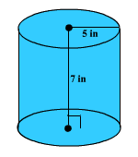
36. Measure the volume of a cylinder using the equation V = πr²h. Include units.
V = (3.14)(25)(7)
V = 548.5 in.³

Slide 41
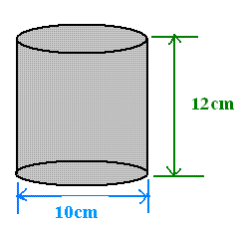
37. Measure the volume of a cylinder using the equation V = πr²h. Include units.
V = (3.14)(5²)(12)
V = (3.14)(25)(12)
V = 942 cm³

Slide 42
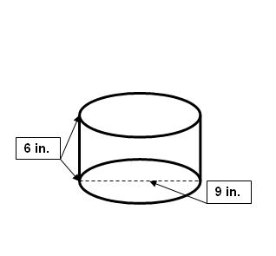
38. Measure the volume of a cylinder using the equation V = πr²h. Include units.
V = (3.14)(4.5²)(6)
V = (3.14)(20.25)(6)
V = 381.51 in³

