Slide 1
Pure Substances & Mixtures Notes

Slide 2
Matter
Pure Substances
-Cannot be physically separated
Mixtures
-Can be physically separated
-when there are 2 or more substances
Elements
-simplest substance found in nature
Examples:
Aluminum
Oxygen
Compounds
-Two or more elements are chemically joined
Examples:
Water – H₂O
Salt – NaCl
Solutions
-All parts look the same after mixed (homogeneous)
Examples:
Salt Water
Milk
Visible Mixtures
-Two or more parts are visible (hetrogeneous)
Examples:
Pizza
Salad

Slide 3
Item | Pure Substance/ Mixture | Explanation
1.
2.
3.
4.
5.
6.
7.
8.
9.
10.
11.
12.

Slide 4
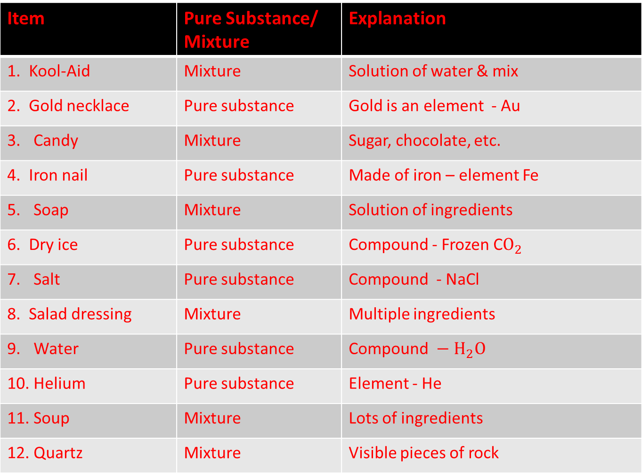
Item | Pure Substance/ Mixture | Explanation
1. Kool-Aid | Mixture | Solution of water & mix
2. Gold necklace | Pure substance | Gold is an element - Au
Candy | Mixture | Sugar, chocolate, etc.
4. Iron nail | Pure substance | Made of iron – element Fe
Soap | Mixture | Solution of ingredients
6. Dry ice | Pure substance | Compound - Frozen C$O_{2}$
Salt | Pure substance | Compound - NaCl
8. Salad dressing | Mixture | Multiple ingredients
Water | Pure substance | Compound$− H_{2}O$
Helium | Pure substance | Element - He
Soup | Mixture | Lots of ingredients
Quartz | Mixture | Visible pieces of rock

Slide 5
Making Solutions
To dissolve: to form a solution by mixing evenly
An object/substance is…
…soluble if it dissolves when mixed.
ex:
…insoluble if it does not dissolve when mixed.
ex:

Slide 6
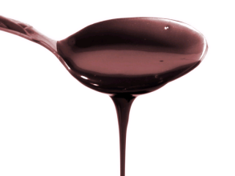
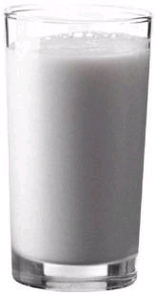
Solvent – substance that dissolves another substance to make a solution
Solute – substance being dissolved
Ex:
Chocolate syrup
SOLUTE
Milk
SOLVENT

Slide 7
(Identify the solvent and solute in the example below)
Ex: Making Kool-Aid
Water:
Sugar mix:

