Slide 1
Physical Properties Notes

Slide 2
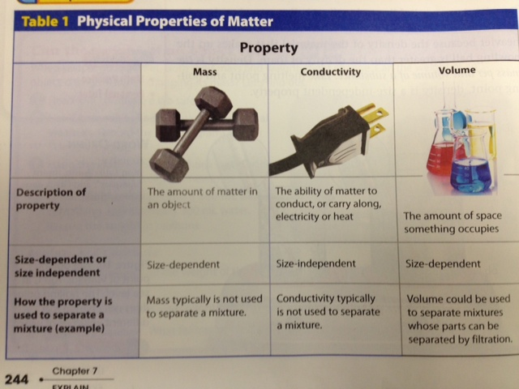

Slide 3
