Slide 1
Mass & Volume Notes

Slide 2
Matter
Anything that has mass and takes up space.

Slide 3
Mass
The amount of matter in an object.
Measured on a scale
  Triple-beam balance
  Digital

Slide 4
Units for Mass:
Grams – g
Kilograms – kg
1 kg = 1000 g
1 kg = the mass of bottled water
1 kg ~ 2 pounds (lbs)
What is my mass in kg?
(Your weight ÷ 2 ~ ________ kg)
Weight – a measure of the gravitational force exerted on an object

Slide 5
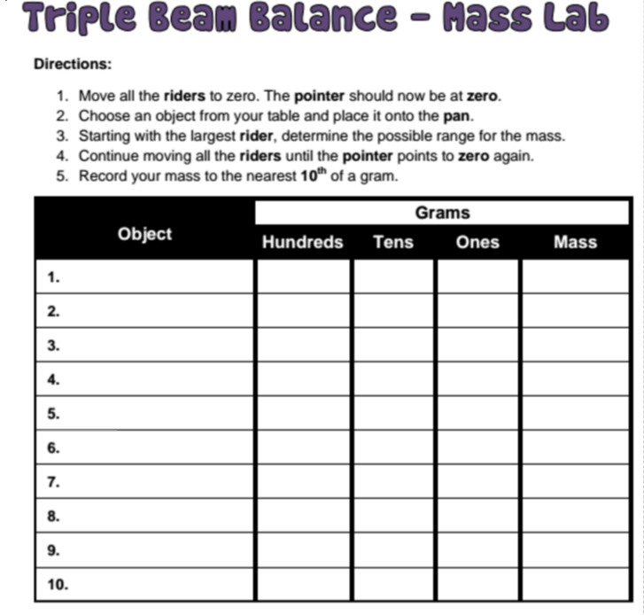

Slide 6
Differences Between Weight & Mass
Weight
Measure of the gravitational force on an object
Varies depending on where the object is in the universe
Measured by using a spring scale
Newtons, pounds, kg
Mass
Measure of the amount of matter in an object
Always constant for an object no matter where in the universe
Measured by using a balance
Units: g & kg

Slide 7
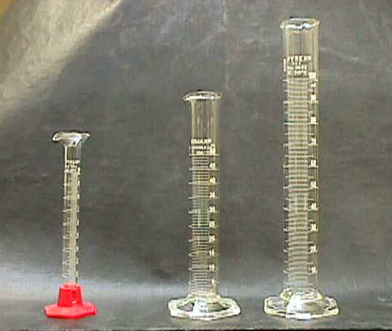
Volume
How much there is or how much space it takes up.
Cubic centimeters
  cm³
Milliliters
  mL

Slide 8
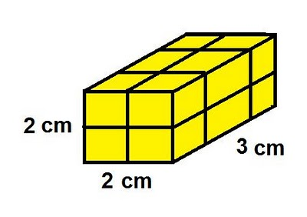
Method #1
Solid objects that are regularly shaped.
Use formulas.
LxWxH
cm³

Slide 9
Example 1
V = L x W x H
  L = 23 cm
  W = 12 cm
  H = 9 cm
V = 23 cm x 12 cm x 9 cm = 2,484 cm³

Slide 10
Example 2
Choose a rectangular prism:____________
L = ______cm
W = ______ cm
H = ______cm
V = L x W x H
_____ cm x _____ cm x _____cm = ______cm³

Slide 11
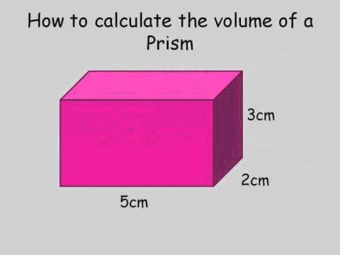
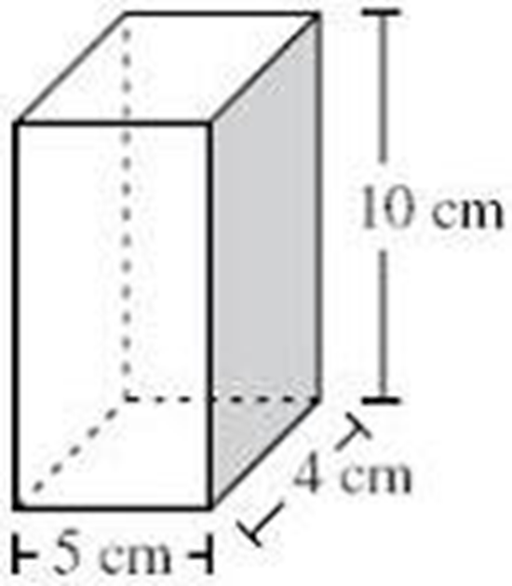

Slide 12

Volume of a Cylinder (Challenge only)
Vol$=πr^{2}$h
  π = 3.14
  r = radius (half the diameter)
  h = height

Slide 13
QOD #10
Calculate the volume of a box with sides equal to 50 cm, 40 cm, and 10 cm.

Slide 14
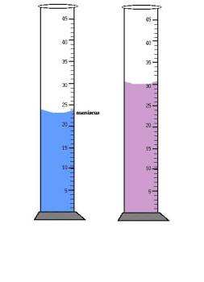
Volume Notes (cont.)
Method #2
Measure liquids with a graduated cylinder.
mL
Measure from the bottom
of the meniscus (curve).

Slide 15
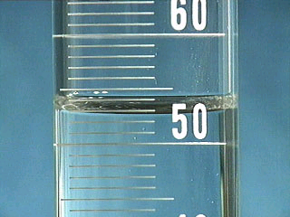
What is the volume of this liquid?
53 mL

Slide 16
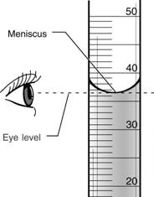
Measuring Volume Activity
Station # | Type of Liquid | Measurement in mL
1
2
3
4
5
6
7
8
9
10

Slide 17
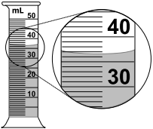
QOD #11
Find the volume of an object that measures 4 cm x 5 cm x 10 cm.
Find the volume of the liquid below. Sketch the drawing in your notebook.

Slide 18
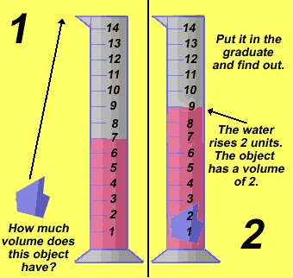
Finding Volume Method #3 – Water Displacement
Volume of irregularly shaped objects.
  Measured in cm³
  1mL = 1cm³

Slide 19
Steps
Pour water into a graduated cylinder and record the measure.
Carefully slide the object into the water and record the new measure.
Subtract the two measures and change the units to cm³.

Slide 20
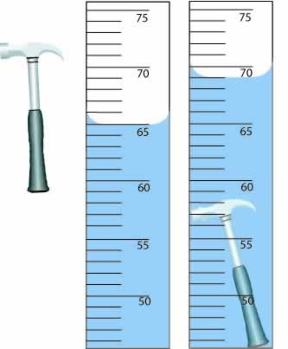
QOD #12
EXPLAIN (write the steps) how to find the volume of the hammer. Include the answer with units in your explanation.
(You may use numbered, detailed steps or write it in paragraph form.)

Slide 21
Item | Vol. of water only – in ml | Vol. of water w/item - m | Subtract – ml | Vol. of item in cm³
Toy car
key
Ping pong ball
Bouncy ball
5 pennies

