Slide 1
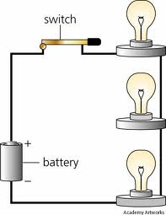
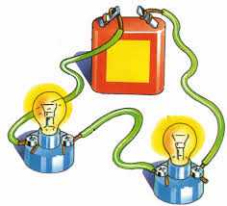
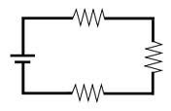
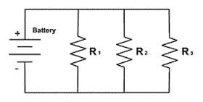
QOD #38
Parallel
Series
Series
D. Series
E. Parallel
Label the circuits as series or parallel.
B
C
A
D
E
D

Slide 2
Magnetism!

Slide 3
Magnet – A device that attracts certain materials, such as iron, nickel, and cobalt.
All magnets have two POLES, or ends.
Magnetic force – the attractive or repulsive force between the poles of magnets.
North pole will attract the south pole of another magnet.
Opposite pole attract; like poles repel.

Slide 4
Permanent magnet – will hold its magnetic properties over a long period of time. Usually made of iron alloys, nickel, or cobalt.
Temporary magnet – an object that has been magnetized by contact with a magnet (rubbing) will lose its magnetism quickly.
Dropping or heating a magnet can cause it to lose its magnetism.

Slide 5
Magnetic field – the space around a magnet where there is magnetic force.
Lines of force (or flux)– the lines around the poles of a magnet that indicate the direction of the magnetic field.
Magnetic domain – region where all the atoms point in the same direction.

Slide 6
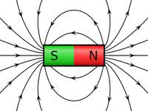
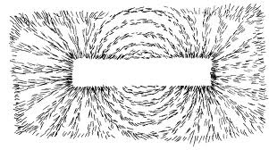
Magnetic Lines of Force
A bar magnet and its magnetic field - be sure to label the poles.

Slide 7
Hypothesis: If ___________________________, then __________________________________,
because _______________________________.
Materials: 4 magnets, a paperclip, a wooden tongue depressor, small washers, 2 cups
IV:
DV:

Slide 8
QOD #39
Draw a diagram of the charges on a balloon and a sweater after the balloon is rubbed on the sweater. (Show the + and - charges)

Slide 9
Stations – 10 min each
Station 1 – Water Pan Compass
Station 2 – Bag O’ Stuff
Station 3 – Magnetic Fields

Slide 10
Bag O’ Stuff Activity
Object – Is it magnetic? | Hypothesis (Yes/No) | Result (Yes/No)

Slide 11
Magnetic Field Observations (Answer the ?s - PQPA)
Draw a diagram of the observed pattern of iron filings.
The observed pattern represents the magnetic field for the magnet. How far away does the field extend? Measure and record this distance. _____________
Where do most of the iron filings go?
How can the magnet attract the iron filings without touching them?

Slide 12
Build a water pan compass
Place the bar magnet on the small plate.
Float the small plate in the pan of water.
Once the plate stops moving, check the direction it is pointing using the small compass.
In your notebook, draw the water pan compass. Make sure that you label the poles of the magnet and which direction each pole is pointing according to your “real” compass.
Remove the small plate and magnet from the pan of water. Clean up your station before moving on.

Slide 13
Making an Electromagnet
Wrap the nail with the black wire about 20 times.
Connect both ends of the wires to a power source.
What has happened to the nail? Will it pick up the paperclips?
Draw a diagram of your electromagnet in your notebook. Be sure to label all parts including the source.
Unwind the wire from the nail and take apart the circuit. Return all of the materials to the bin.

Slide 14
Testing an Electromagnet
Purpose: To determine if the number of coils will affect the strength of an electromagnet.
Question: If we increase the number times the nail is wrapped, will the electromagnet be able to pick up more paperclips?

Slide 15
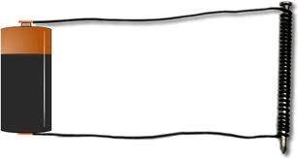
Procedure:
Wrap the nail 10 times with the wire.
Connect the ends of the wires to the battery and the switch.
See how many paperclips the nail will pick up and record the results.
Wrap the nail 20, 30, and 40 times and retest.
Caution: All metal, including the nail, will become hot as the circuit is connected. Use the switch!

Slide 16
Hypothesis: If ___________________________, then ___________________________________, because ________________________________.
Materials: battery, battery holder, switch, wires, nail, paperclips
IV:
DV:

Slide 17
Data table
Number of wraps | Number of paperclips picked up
10
20
30
40

Slide 18
Power Conclusion

Slide 19
QOD # 81
What materials are good conductors of electricity and also are attracted to magnets? Why is this?
(Hint: Look back at your notes!)

Slide 20
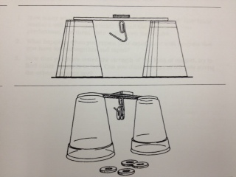
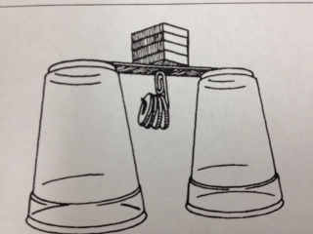
Measuring Magnetic Strength Lab

Slide 21
Measuring Magnetic Strength
Purpose: To measure the strength of magnets.
Question: How many washers will one, two, three, or four magnets be able to hold?

Slide 22
Procedures:
Place a magnet on a wood tongue depressor laying across two upside down cups.
Bend the paperclip to make a hook for the washers and suspend it with the magnet underneath the tongue depressor.
See how many washers the paperclip will hold until it falls. Record the number in your table. Complete a total of three trials and find the average.
Stack another magnet on top of the existing one and try the experiment again.
Add magnets one at a time and record your data.

Slide 23
Data Collection:
Number of Magnets | Trial #1 | Trial #2 | Trial #3 | Average of three trials
1
2
3
4

Slide 24
Create a graph
Choose the graph you think will best display your data.
Make sure it is neat and you include:
A title
Labels for the axis
Even intervals

