Slide 1
Sources of Light
Luminous- Objects that generate their own light
Example: Sun, Stars, Fires
Illuminated- Objects that reflect light to be seen
Example: Windows, mirrors, moon, anything you can see

Slide 2
Where does light come from?
Sun
Light fixtures
Fire
Bioluminescence
Any others??

Slide 3
What is light?
Electromagnetic waves/ radiant energy
Electromagnetic waves are waves of electricity and magnetic energy given off from a charged particle (photon)

Slide 4
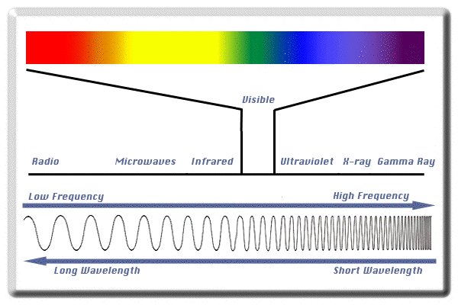
Electromagnetic Spectrum
ROY G BIV

Slide 5
Light travels
Through TRANSVERSE WAVES
In a straight line
At 300,000 km/s

Slide 6
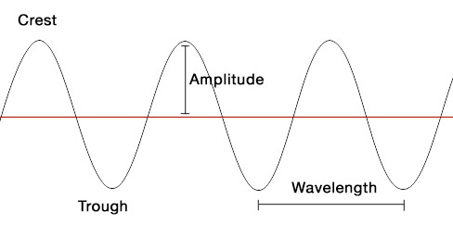
Transverse Waves

Slide 7
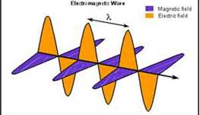
Light travels in a straight line

Slide 8
Light – Goal 4

Slide 9
When light hits a surface, it…
Reflects- light bounces off
Absorbs- light is absorbed into the material
Transmits- allows light to pass through

Slide 10
Transparent materials
Light is able to completely or almost completely pass through
Ex: Glass,

Slide 11
Translucent materials
Light is mostly able to pass through but is blurred or fuzzy
Example: Frosted glass,

Slide 12
Opaque materials
No light is able to pass through and is either reflected or absorbed
Example: wood,

Slide 13
Law of Reflection
When a wave is reflected from a surface the angle of reflection is equal to the angle of incidence

Slide 14
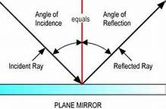
Angle of Incidence and Reflection

Slide 15
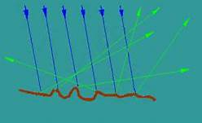
Diffused Reflection
Reflection of light from a rough surface (cannot see a reflection)

Slide 16
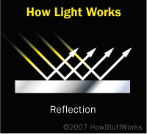
Regular reflection
Reflection of light from a smooth surface (you can see a reflection)

Slide 17
Laser Pointer Reflection
Purpose: To compare the reflection of visible light from different surfaces. (smooth, rough, shiny, dull)
Prediction: What types of surfaces will cause regular reflection and which will cause diffused reflection?

Slide 18
Data Table
Object | Surface type | Reflection

Slide 19
Reflection Challenge!
Station # | # of Mirrors
1
2
3
4
5
6

Slide 20
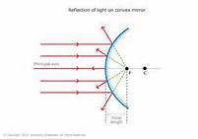
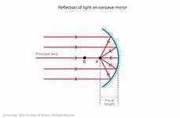
Convex/Concave Mirrors
Convex Concave

Slide 21
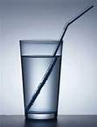
Refraction
Refraction- the bending of light when light waves speed up or slow down as they pass through different substances.

Slide 22
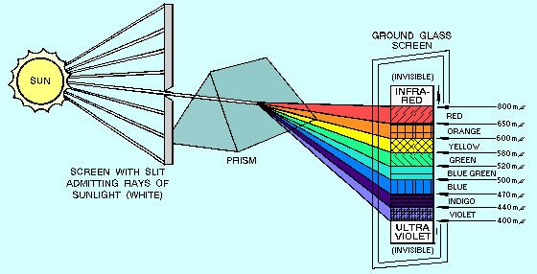

Slide 23
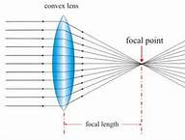
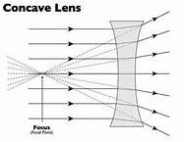
Convex/Concave Lenses
Convex Concave

Slide 24
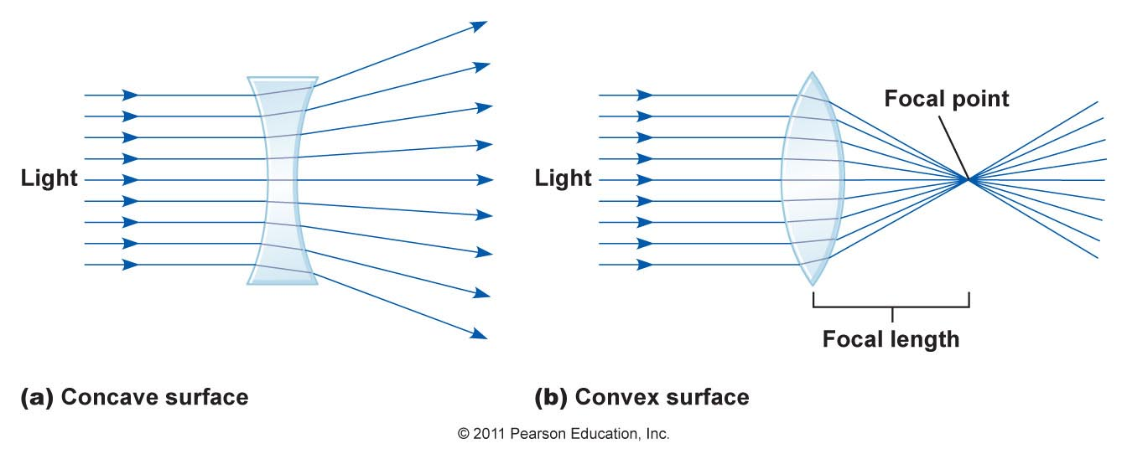

Slide 25
Refraction Pictures

Slide 26
Receivers of Light – Goal 5

Slide 27
What uses light?
Receivers – take in and manipulate light
Example: Our eyes are receivers of light.

Slide 28
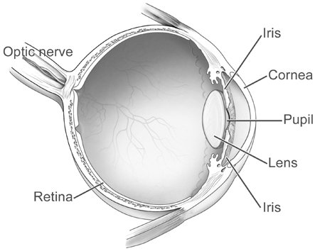

Slide 29
Parts of the Eye:
Cornea- where the light from outside your eye is refracted inward
Iris- the shutter of the eye that enlarges/ shrinks to allow more or less light in
Pupil- the hole that light passes through to get into the inner eye

Slide 30
Lens- focuses light that enters the eye to form images on the retina
Retina- where light is transferred into a signal to be sent to the brain
Optic nerve- carries the signals from the retina to the brain where it is turned into an image

Slide 31
Videos:
http://youtu.be/YjxAUb1W-Rw

Slide 32
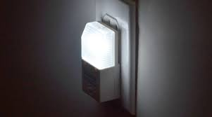
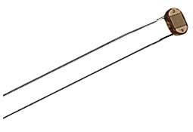
Photocells
Photo-resistor – Uses a semiconductor to sense changes in light. Used in nightlights, cameras, street lights (to sense when to turn on).

Slide 33
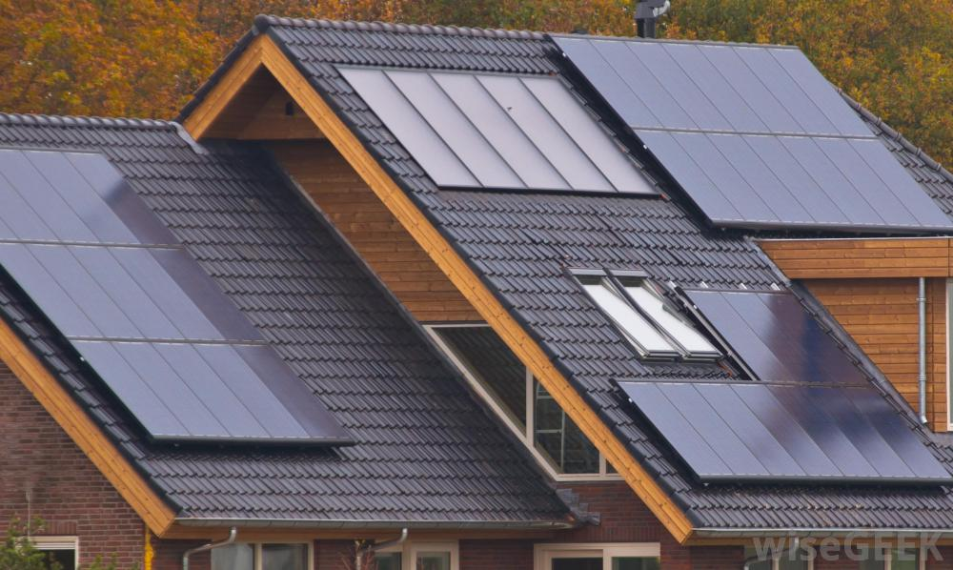
Photovoltaic Cell – Creates electricity when electromagnetic radiation hits it. Used in solar panels.

