Slide 1
Science Class Reminders and Updates!
Your 2nd semester notebook is due in class by Monday!
Every assignment counts! Assume that everything that you are given is for a grade, because it could be. If it’s not, it is still given for a reason and will help you learn what you need to know for the test/quiz!

Slide 2
Forms of Energy

Slide 3
1. Radiant Energy (Light Energy)
Energy carried by an electromagnetic wave.
ex: sunlight, radio waves, microwaves

Slide 4
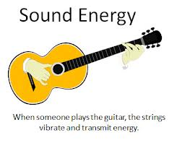
2. Sound Energy
Energy that is caused by an object’s vibrations.
ex: playing a guitar (plucking the strings)

Slide 5
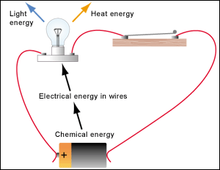
3. Chemical Energy
Stored energy in chemical compounds
ex: stored and released energy from food molecules, batteries, fireworks, gasoline

Slide 6
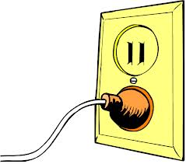
4. Electrical Energy
The energy of moving electrons (electric currents)
ex: electrical appliances, static electricity

Slide 7
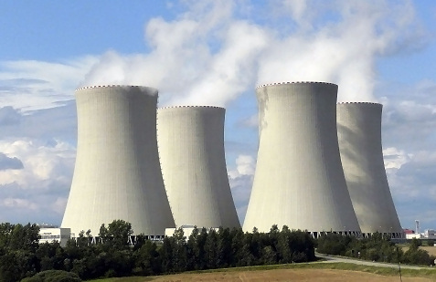
5. Nuclear Energy
Energy that is stored in the nucleus of an atom.
ex: splitting the nucleus of atoms (energy fission)

Slide 8
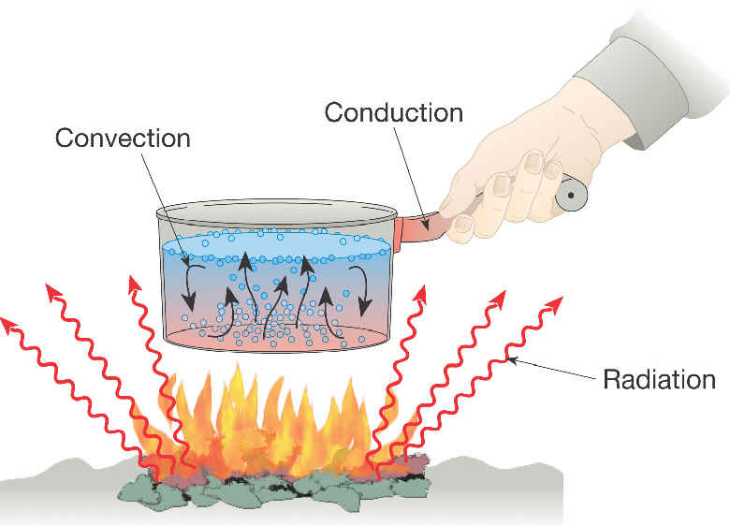
6. Thermal Energy
Energy due to the random motion (kinetic energy) of molecules or atoms in a substance.
ex: Particles of water vapor move faster than those of ice, having more thermal energy

Slide 9
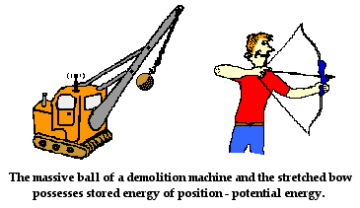
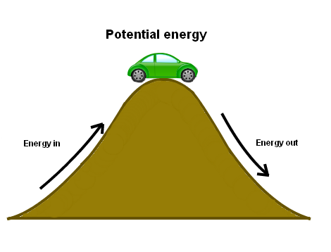
7. Potential Energy
The stored energy based on an object’s position or shape.

Slide 10
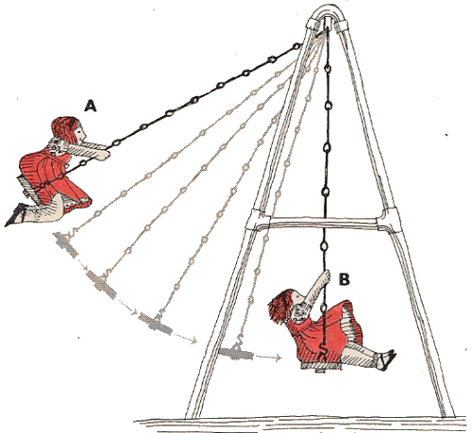
8. Kinetic Energy
The energy of motion.

Slide 11
9. Mechanical Energy
The total energy of motion and position of an object (both potential and kinetic energy).
ex: movement of a car down a hill

Slide 12
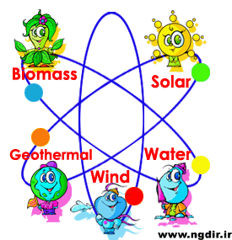
10. Renewable Energy
Energy that comes from resources that are continually replenished (restored).

