Slide 1
QOD #15 (on paper)
Mr. Walker has a mass of 75 kg on Earth. What would his mass be on the moon? What would his mass be on Mars?

Slide 2
QOD #16
Draw and fill in the table. Try to list 5 of each.
Items that sink | Items that float

Slide 3
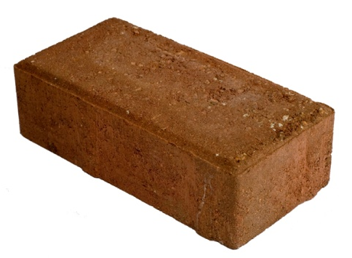
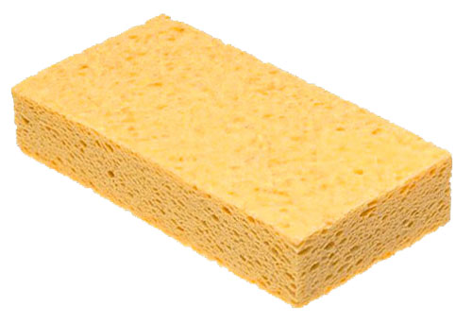
Density – the amount of matter in a given space, or volume.
Brick & Sponge
The brick has more mass than the sponge.
Brick has a greater density.
Density Notes

Slide 4
D=density M=mass V=volume
D = M
V D =
Units for density:
g/cmᵌ
g/mL
kg/mᵌ
kg/L

Slide 5
Example: What is the density of an object whose mass is 25 g and whose volume is 10 cm³?
D = M
V
D = 25 g
10 cmᵌ
D = 2.5 g/cmᵌ

Slide 6
Practice
Find the density. M = 10 g V = 2 mL
D = 10 g / 2 mL
D = 5 g/mL
Find the density. M = 600 g V = 50 cmᵌ
D = 600 g / 50 cmᵌ
D = 12 g/cmᵌ

Slide 7
Sink or Float??
Object | Prediction (sink or float) | What happened?
Rock
Golf Ball
Lemon
Lime
Coke
Diet Coke
Apple
Wood
Paper Clip
Banana

Slide 8
Why did the objects sink?
The objects sank because they are more dense than the water.

Slide 9
What will happen if I pour corn oil into a graduated cylinder of water?
Hypothesis: If I pour corn oil into a graduated cylinder of water, then ….. because …. .

Slide 10
Diagram:
Conclusion:
When I poured the corn oil on the water …
Objects and liquids that are more dense sink.
Objects and liquids that are less dense float or rise.

Slide 11
EXTRA CREDIT!
30th

Slide 12
Vocab Wall
Qualitative Observations
Quantitative Observations
Volume
Graduated Cylinder
Meniscus
Triple Beam Balance
Mass
Weight
Density

Slide 13
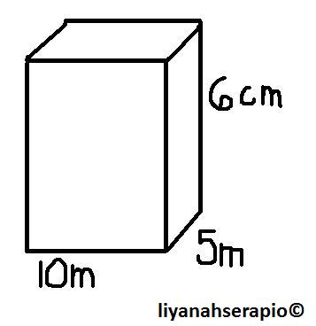
QOD #19
Find the density of the box if it has a mass of 500 grams.
Would it sink or float in
water?
cm
cm

Slide 14
Density Practice - Challenge
Object | Mass | Length | Width | Height/ Thickness | Volume | Density
Notebook
Phone
Toy car |  |  |  |  | (Water Displacement)
Metal cylinder |  |  | Radius |  | $V=πr^{2}$h

Slide 15
Density Practice
Object | Mass | Length | Width | Height/ Thickness | Volume | Density
Notebook
Phone
Tissue box
(your choice)

