Slide 1
QOD #29
What is happening when you are brushing your hair and it starts going all over the place? (Explain using what you have learned this week about charges – don’t just say “static electricity.”)

Slide 2
Circuits
Electric Circuits – a complete, closed path through which electrons can flow.
Glue in “Secret Language” Handout

Slide 3
Activity #1: Simple Circuit
Draw at least one of your circuits.

Slide 4
Conductors of Electricity?
Materials | Prediction (yes or no) | Insulator or Conductor
Straw
2. Aluminum foil
3. Paper clip
4. Copper nail
5. Glass
6. Fleece
7. Pencil lead
8. Penny
9. Brass fastener
10. Tooth pick

Slide 5
Conductors of Electricity
Conductors – transfer electrons through it easily
Insulators – do not transfer electrons through it easily

Slide 6
Questions
Which materials conducted an electric current?
Why do we use a conductor in an electric circuit?

Slide 7
Switches
Follow the directions to make a switch with your partner.
Materials: notecard, paper fasteners, paper clip, tape
2. Add the switch to a simple circuit and turn the light bulb on and off with the switch.
3. Draw a diagram of the circuit with a switch in your notebook.

Slide 8
QOD #30
Draw a diagram of a simple circuit with the switch open and one with the switch closed. Circle the drawing where the bulb would be lit.

Slide 9
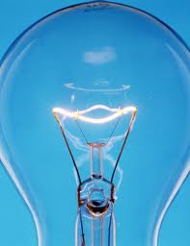
Light Bulb Filament
3-15-13
A filament is the little wire inside of a light bulb, with a high melting point, that glows and gives off visible light.

Slide 10
Making a Filament Lab
Follow the directions of the hand out to make a filament.
Safety:
The nichrome wire is thin and can cut the ends of your fingers if you pull it too hard.
Make sure the wires to your batteries are disconnected while wrapping the nichrome wire.
Do not touch the nichrome wire once the circuit is closed. It gets very hot! You can burn yourself!
Draw a picture of the set up required to make a filament. Label the parts.
Clean Up: We are going to re-use the nichrome wire. When directed, please straighten out the nichrome wire so we can re-use it for the next classes.

Slide 12
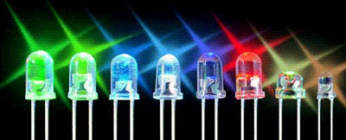
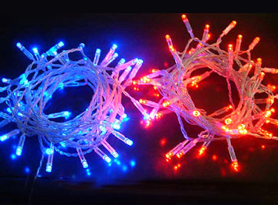
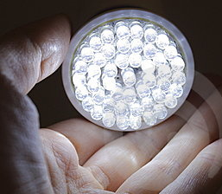
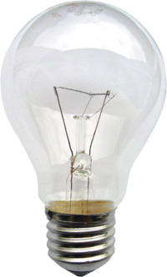
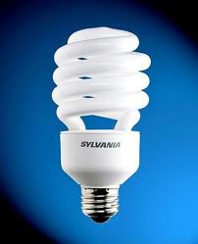
Types of Light Bulbs
Light Emitting Diodes (LEDs)
Ex: light up numbers on digital clocks, traffic signals
Incandescent Light Bulbs – produces light with a filament
Compact Fluorescents (CFLs)

Slide 13
Pros & Cons of Different Types of Lights
Types of Lights | Pros | Cons
Light Emitting Diodes (LEDs)
Incandescent Light Bulbs
Compact Fluorescents (CFLs)

Slide 14
Pros & Cons of Different Types of Lights
Types of Lights | Pros | Cons
Light Emitting Diodes (LEDs) | Uses least amount of energy Lasts longer than other types of bulbs | Expensive
Incandescent Light Bulbs | Inexpensive Gives off a pleasant light | Does not last very long Uses more energy than LEDs or CFLs
Compact Fluorescents (CFLs) | Use a lot less energy than incandescent bulbs Lasts longer than regular incandescent bulbs | More expensive than incandescent bulbs Contains mercury, so it should be recycled

Slide 15
Pros & Cons of Different Types of Lights
Types of Lights | Pros | Cons
Light Emitting Diodes (LEDs) | Uses least amount of energy Lasts longer than other types of bulbs | Expensive
Incandescent Light Bulbs | Inexpensive Gives off a pleasant light | Does not last very long Uses more energy than LEDs or CFLs
Compact Fluorescents (CFLs) | Use a lot less energy than incandescent bulbs Lasts longer than regular incandescent bulbs | More expensive than incandescent bulbs Contains mercury, so it should be recycled

Slide 16
Make a Claim – Paragraph
Write a paragraph about which type of light bulb you would recommend using based on the positives and negatives you listed. Give support for your reasoning based on the specifics from the comparison chart.

Slide 17
QOD#31
Explain how a light switch works. (Be specific about when a switch is open and closed.)

Slide 19
Draw Circuit Configurations
Make a simple circuit to light up a light bulb. Draw a diagram of this working configuration. Label each part.
Make a more complex circuit which lights up one or more light bulbs. Draw a diagram of this working configuration. Label each part.
Make a different complex circuit. Draw a diagram of this working configuration. Label each part.

Slide 20
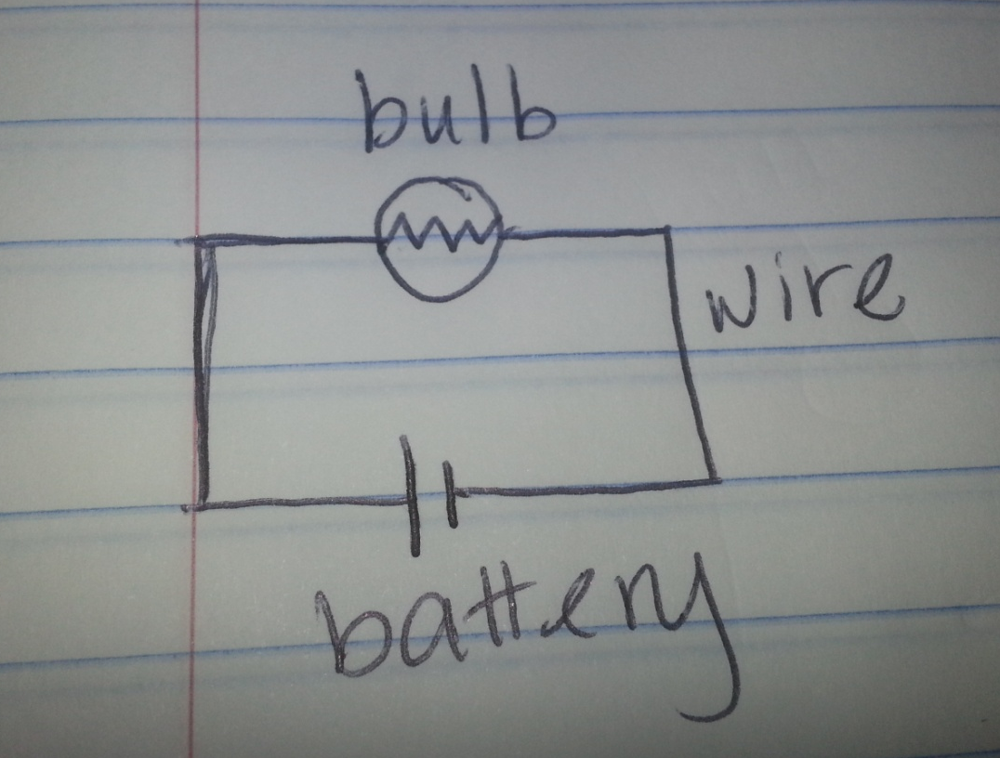

Slide 21
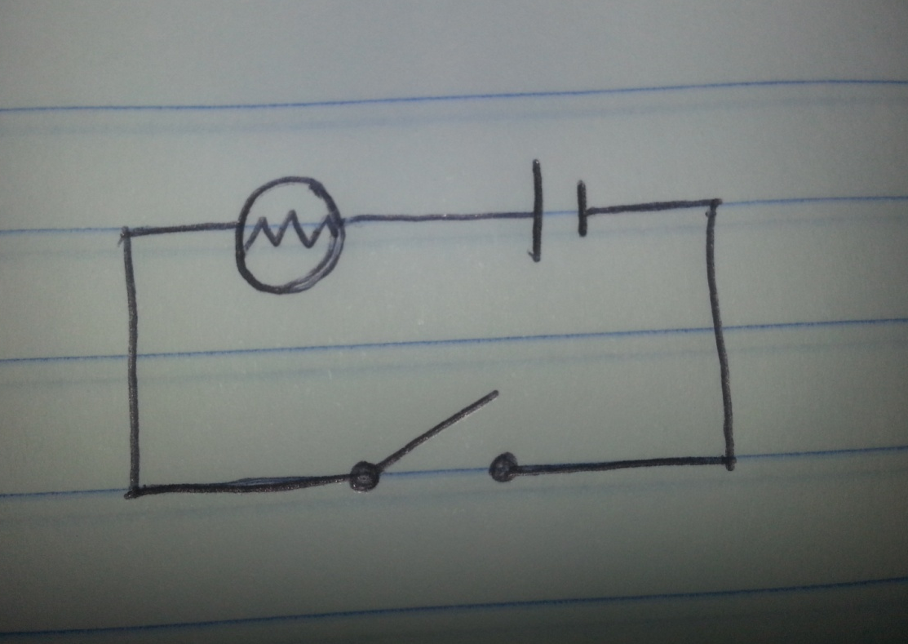
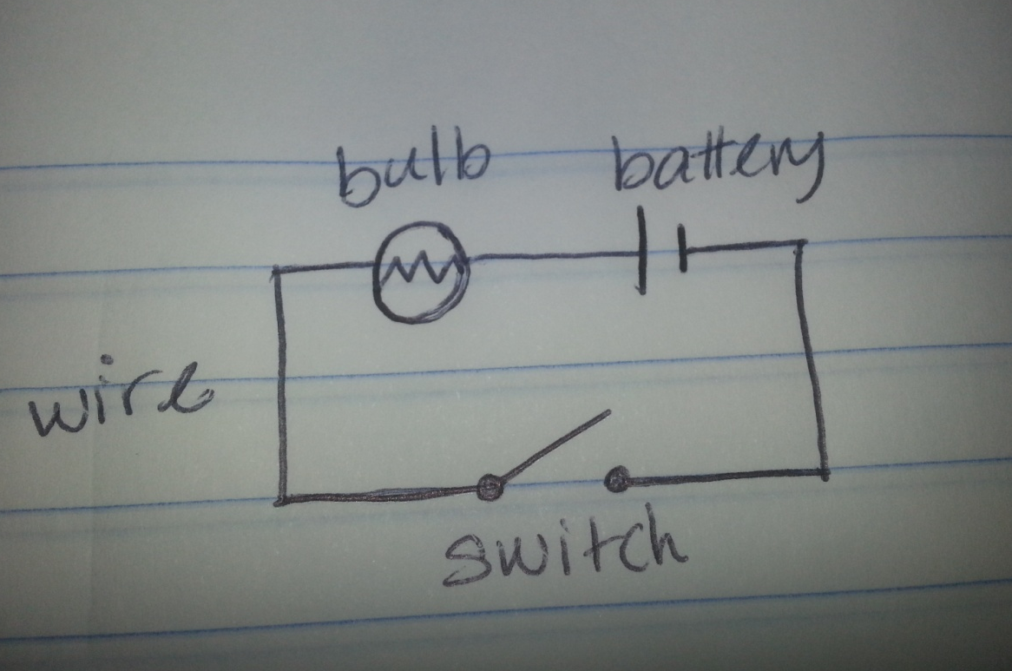

Slide 22
Series Circuit
An electric circuit with only one path for an electric current to flow.

Slide 23
2. Parallel Circuit
An electric circuit with more than one path, or branch, for an electric current to flow.

Slide 24
Create a series circuit.
Unscrew one of the light bulbs.
What happened?
Why does this happen?

Slide 25
3. Create a parallel circuit.
4. Unscrew one of the light bulbs.
What happened?
Why does this happen?

Slide 26
Types of Circuits
Challenge: Start with a circuit with 2 light bulbs. Create a way for one light bulb to be turned off (or unscrewed) while the other stays on.

Slide 28
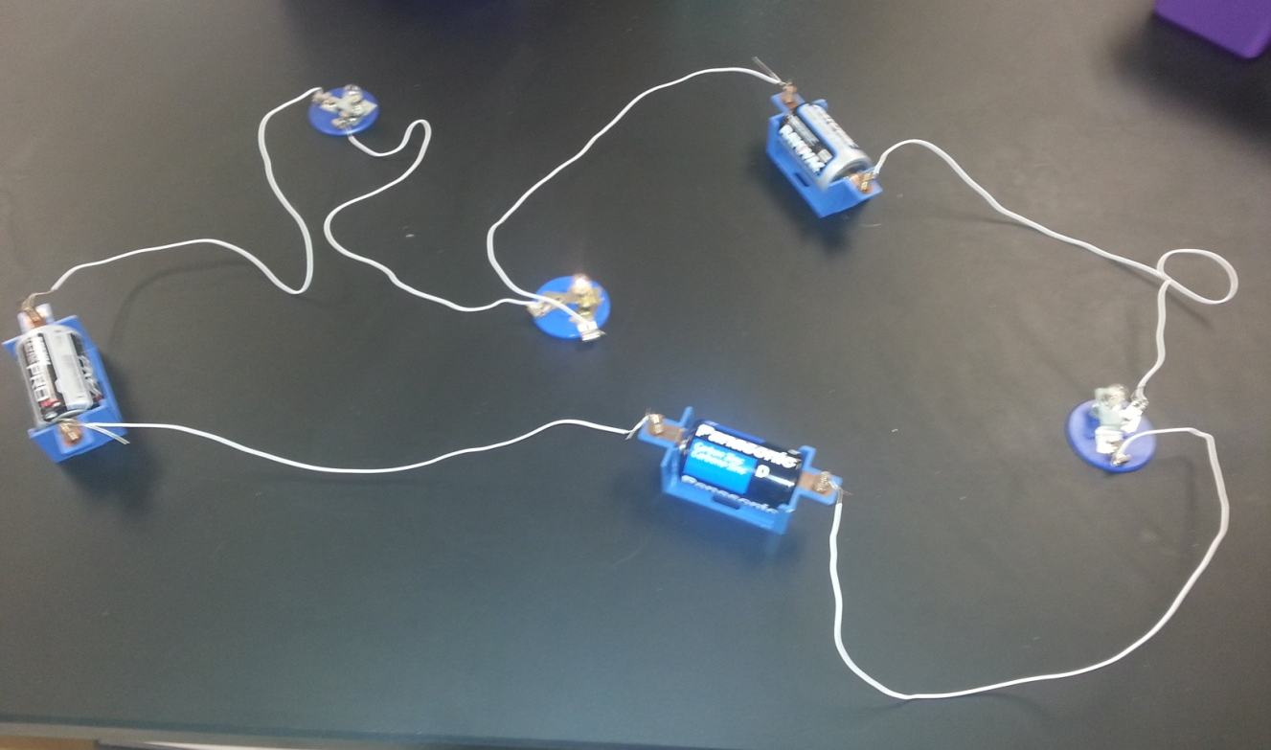
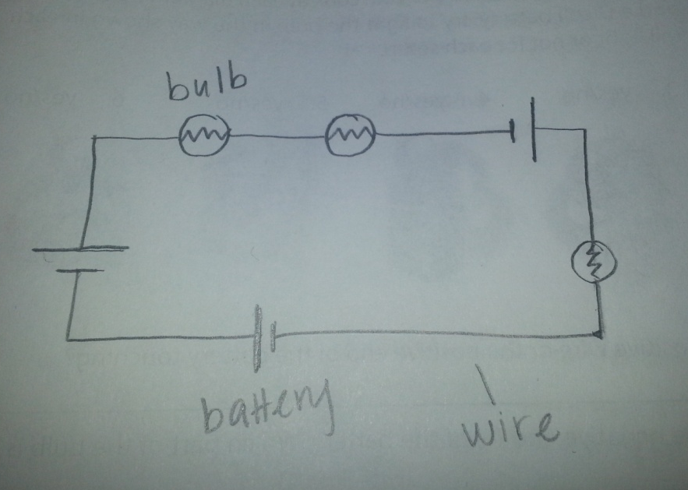
QOD#32
Draw an electrical diagram of the following circuit. Label the different parts.

Slide 29
 | Series Circuits | Parallel Circuits
Advantages
Disadvantages
Examples

Slide 30
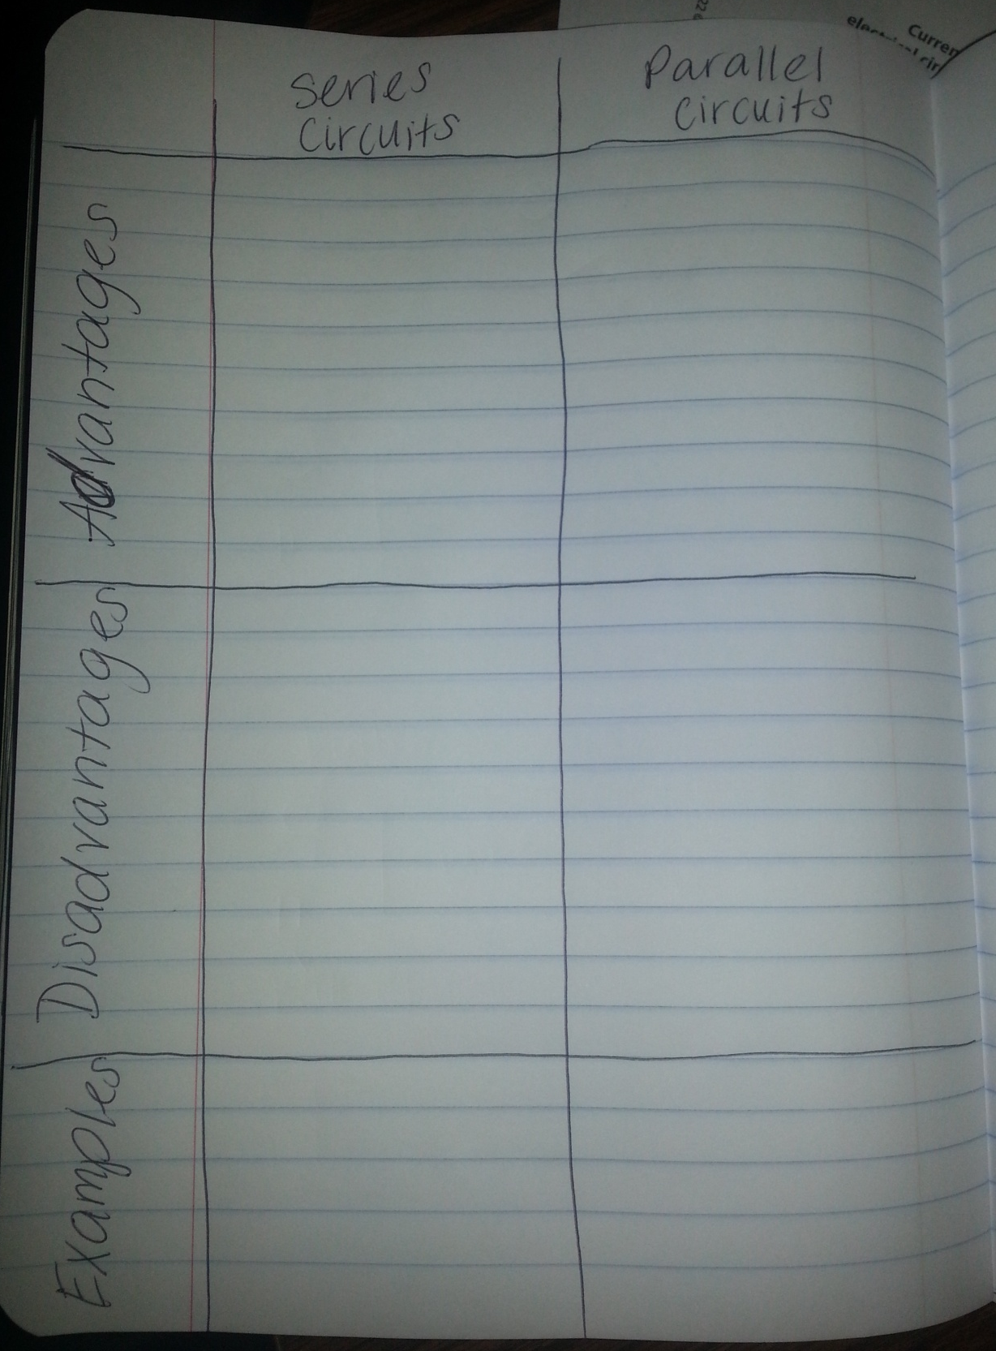

Slide 31
QOD#33
Explain how the two types of circuits are different.

Slide 32
QOD#34
Mrs. Schneider and her husband use about 300 kilowatt-hours (kWh) in a month at their house. If we pay 10 cents per kWh, how much is the electricity bill?
$30.00

Slide 33
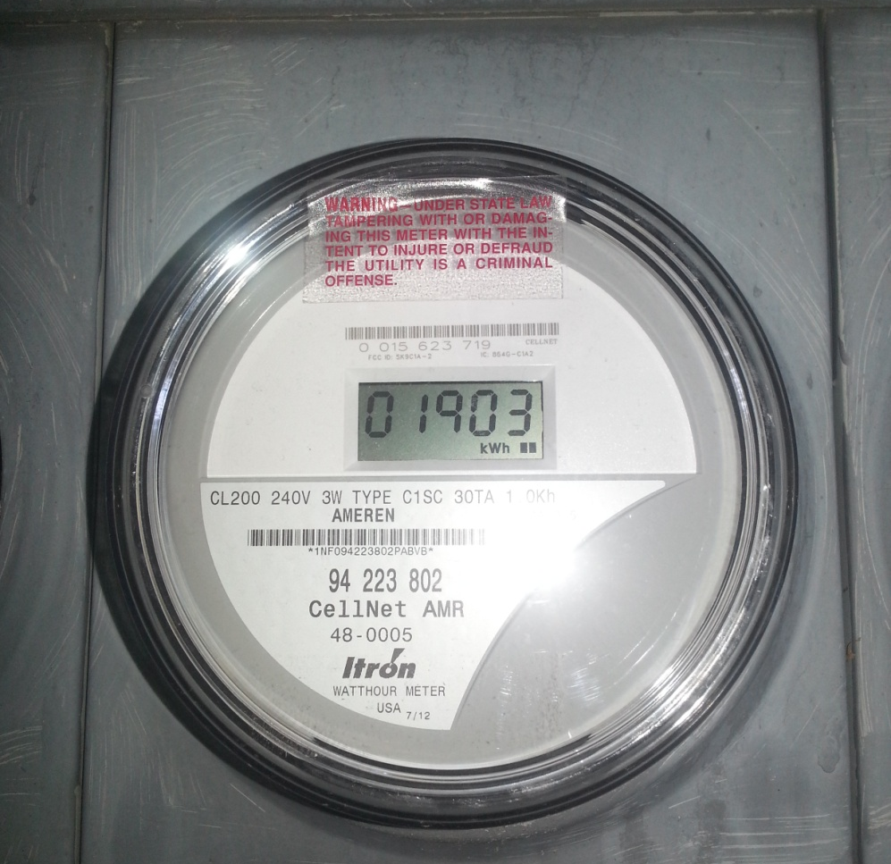
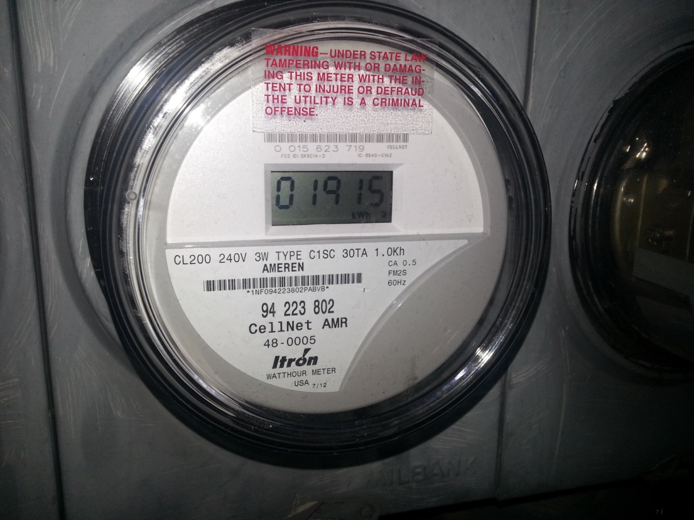
11:00 pm
Saturday Night
11:08 pm
Sunday Night
1,915 kWh – 1,903 kWh = 12 kWh used in 24 hours
How much did it cost?
$1.20

Slide 34
Batteries
Batteries have three parts, an anode (-), a cathode (+), and the electrolyte, a liquid or solid separating them.
The electrolyte in the battery keeps electrons from going straight from the anode to the cathode within the battery. When the + and – ends are connected with wire, electrons can easily flow from anode to cathode.
Batteries convert chemical energy to electrical energy.
Wet and dry cells are classified by the type of electrolyte the battery uses. The electrolyte of a cell may be a liquid or a paste. If the electrolyte is a paste, the cell is referred to as a dry cell. If the electrolyte is a solution, the cell is called a wet cell.

Slide 35
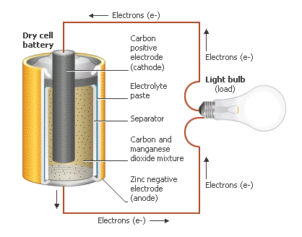
Dry Cell Battery

Slide 36
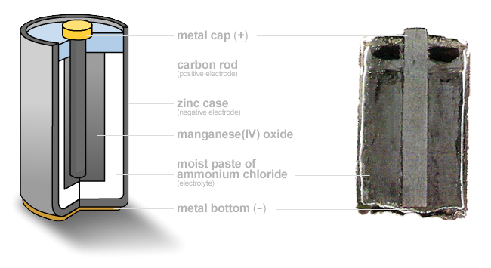

Slide 37
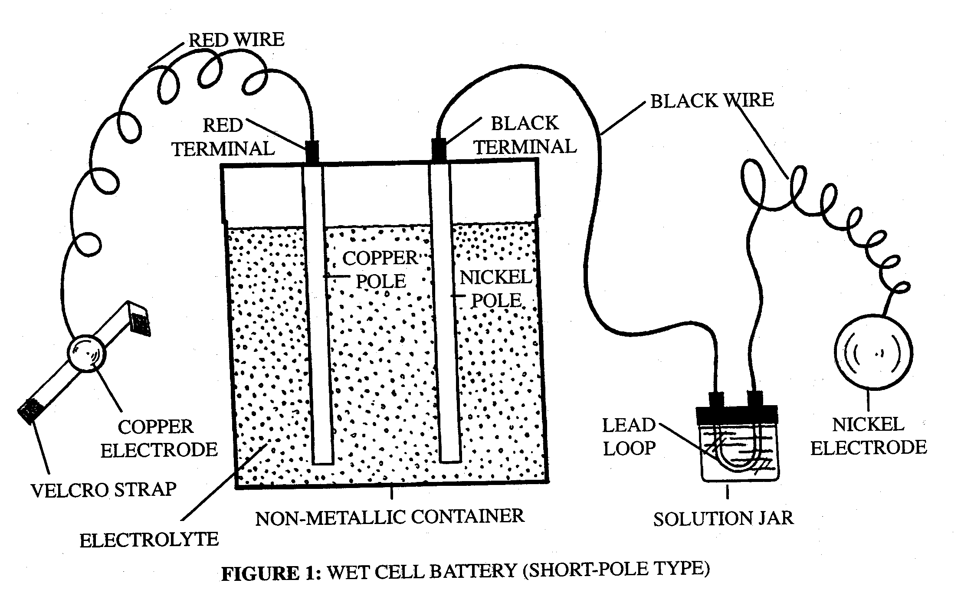
Wet Cell Battery

Slide 38
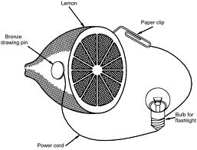
Lemon Battery (Wet Cell)

Slide 39
QOD #35
What was your biggest “A-Ha” moment during the project?

Slide 40
AC/DC
Alternating Current – an electrical current that reverses directions several times per second at regular intervals.
Anything that is plugged in uses this.
Direct Current – an electrical current that travels in one direction.
Flows negative to positive.
Devices that use batteries use DC.
Some devices require an AC/DC converter that turns AC into DC the device can use.

